Slide 1
Automated Position Approval Framework
Artemis

Slide 2
Solution Overview
Power BI
SharePoint Excel File
Power Automate
Reporting Tool
Data Capture
Process Automation

Slide 3
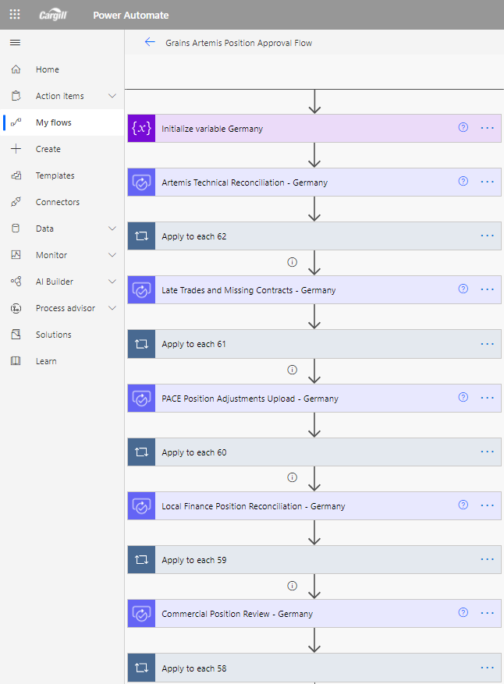
Power Automate
Background
Example Flow
Power Automate is a new enterprise system from Microsoft that enables integration and synchronization of data analysis and applications in an automated way, with the aim of increasing productivity and business efficiency.
This online service, besides automating processes and tasks in a simple and intuitive way, also allows to have a functional flow without the need to develop code (or with a minimum code). Power Automate allows you to connect two or more applications (whether from Office 365 or third parties) and perform actions that automate the most routine business processes.
Some of the functions of this tool are to move data between systems, send reminders about tasks, support data from any API, automate tasks from a local device…

Slide 4
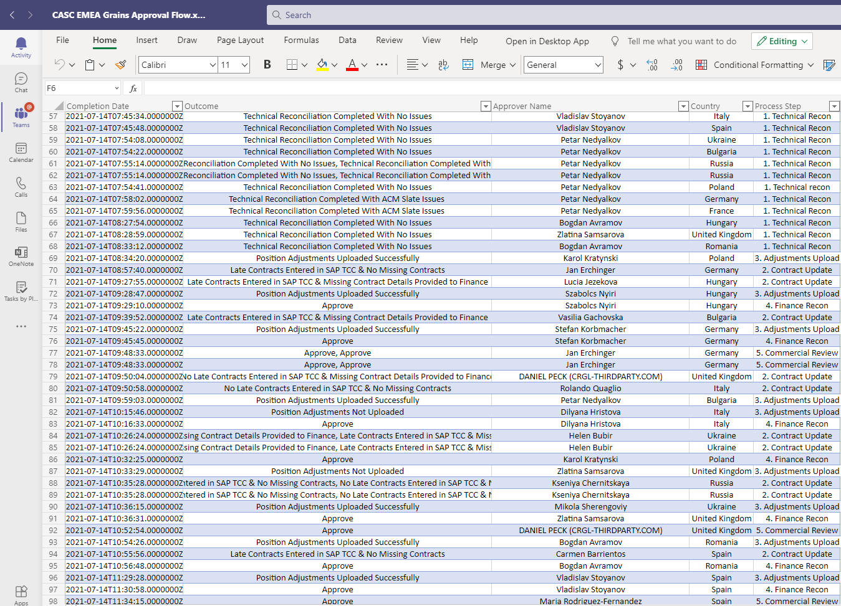
SharePoint Excel File

Slide 5
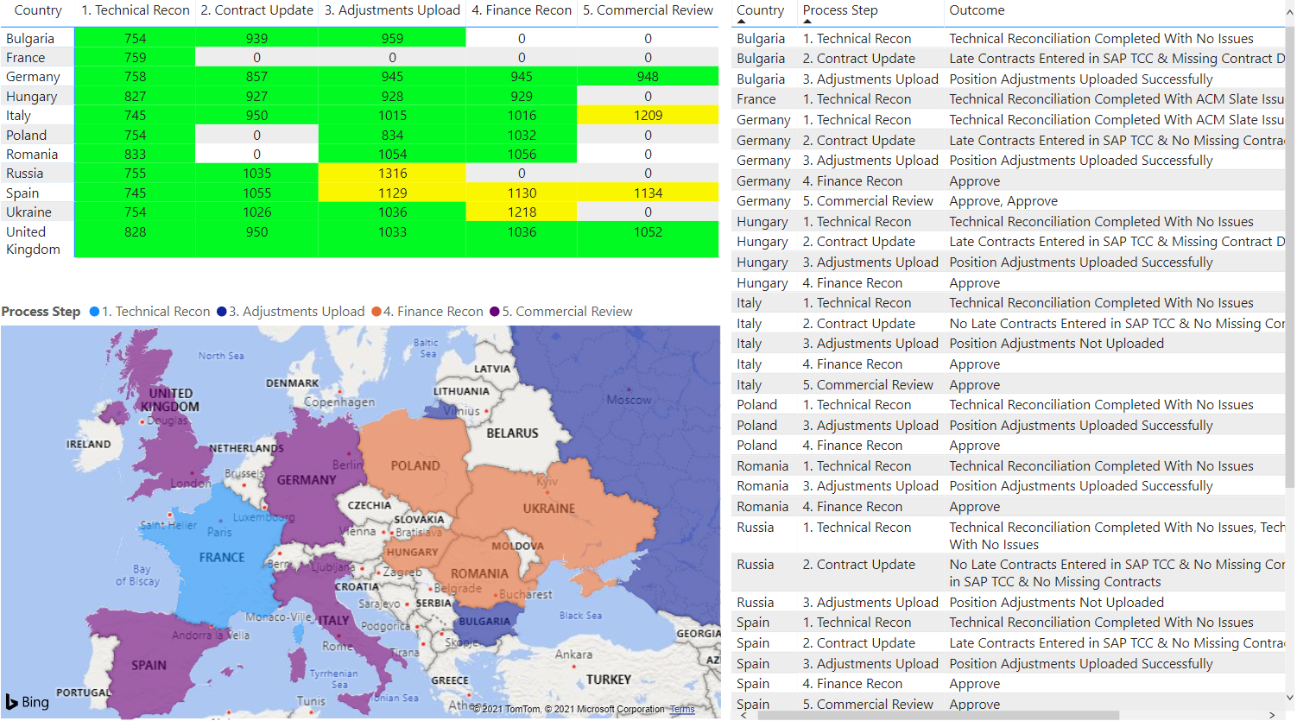
Power BI

